Slide 1

DEPARTMENT OF COMPUTER ENGINEERING, MODELING, ELECTRONICS AND SYSTEM ENGINEERING LM-Telecommunication Engineering: Smart Sensing, Computing and Networking IoT Security Project Title: IoT Sensor Data Monitoring System
Implemented by:
Rami Saleh Hussein Mohammed

Slide 2
Introduction
Overview of the project:
This project demonstrates an IoT-based sensor data monitoring system that:
Collects data from MQ2 (gas sensor) and DHT11 (temperature & humidity sensor) using an ESP32 microcontroller.
Sends the data to a Flask server for processing and storage.
verifies data integrity and authenticity using HMAC-SHA256.
ensures system availability against DOS attack.
Stores data in a MySQL database.
Publishes real-time data to HiveMQ Cloud (MQTT broker).
Display data values in Node-Red dashboard.

Slide 3
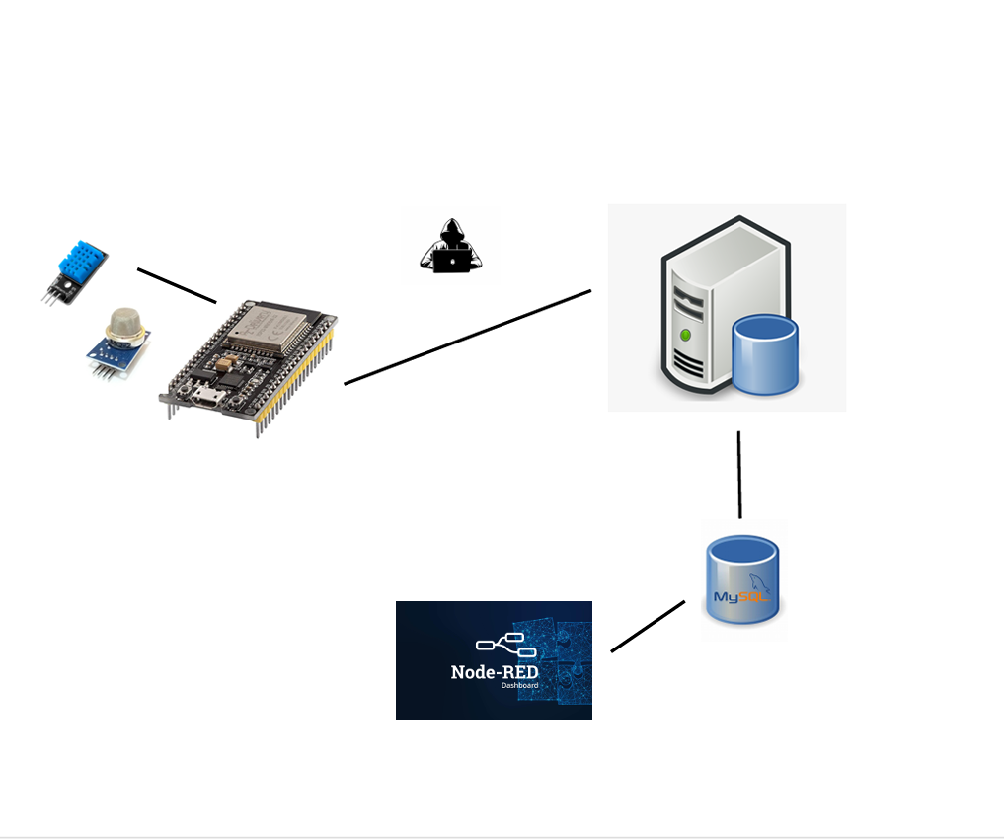
System Architecture
DHT11 & MQ-2 Sensors
Data Tampering
UBUNTU Server
DOS
ESP32
DATA Base

Slide 4
System Architecture
Data Collection Layer: ESP32 + Sensors
Processing Layer: Flask server with security measures
Storage Layer: MySQL database
Visualization Layer: Node-RED dashboard, which provide Real-time Monitoring Features

Slide 5
Data flow in Normal scenario
ESP32 collects sensor readings
Transmitted via HTTP to Flask server
Server receives the data and store it in MySQL database
Data forwarded to Node-Red via MQTT Protocol
Real-time visualization on Node-Red dashboard

Slide 6
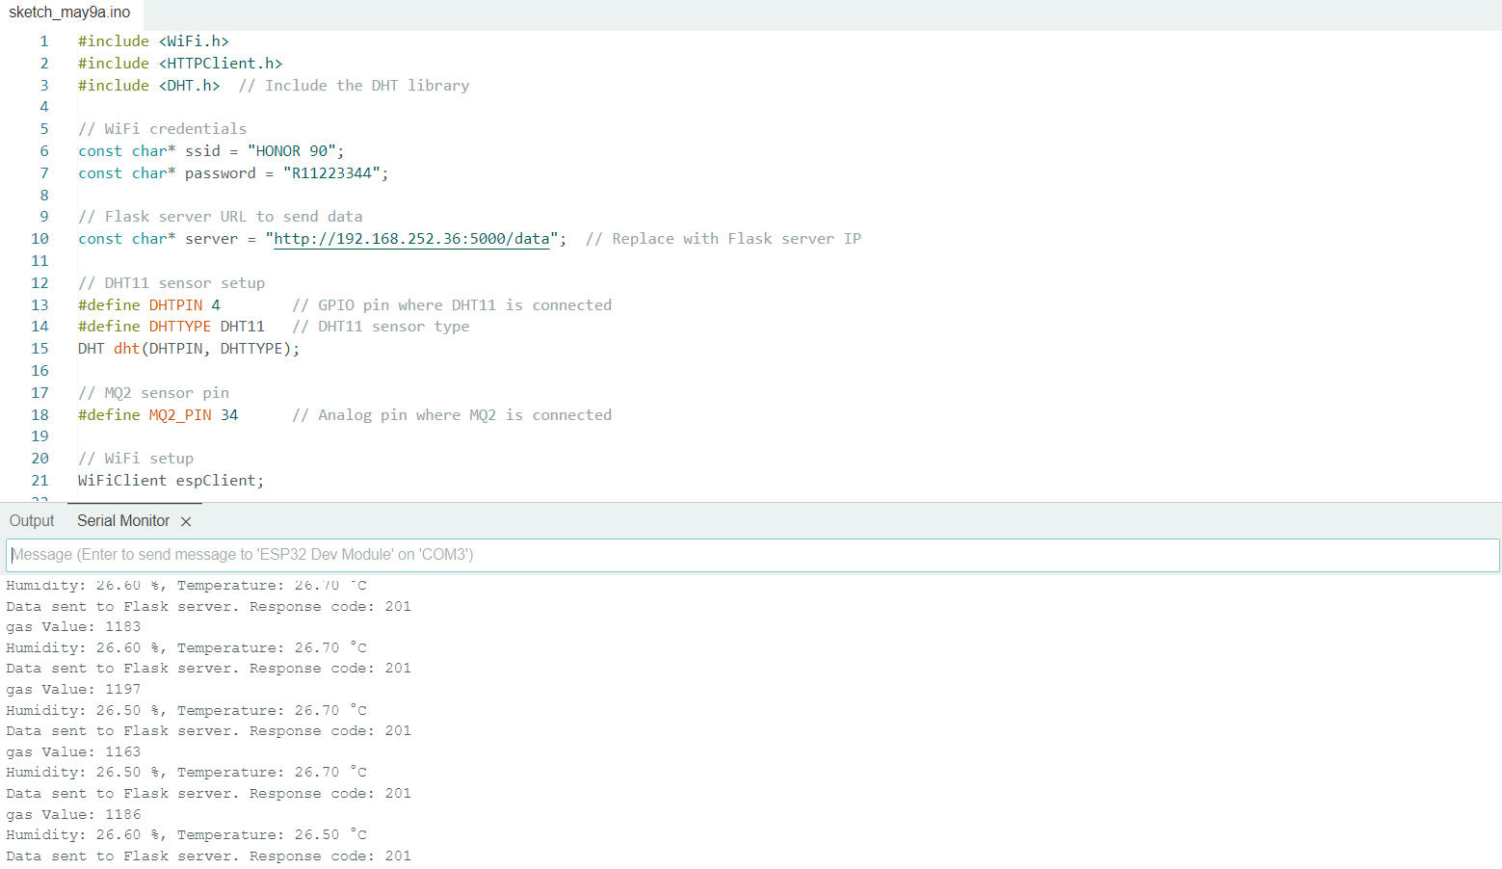
Data flow in Normal scenario
ESP32 sends data to the Server

Slide 7
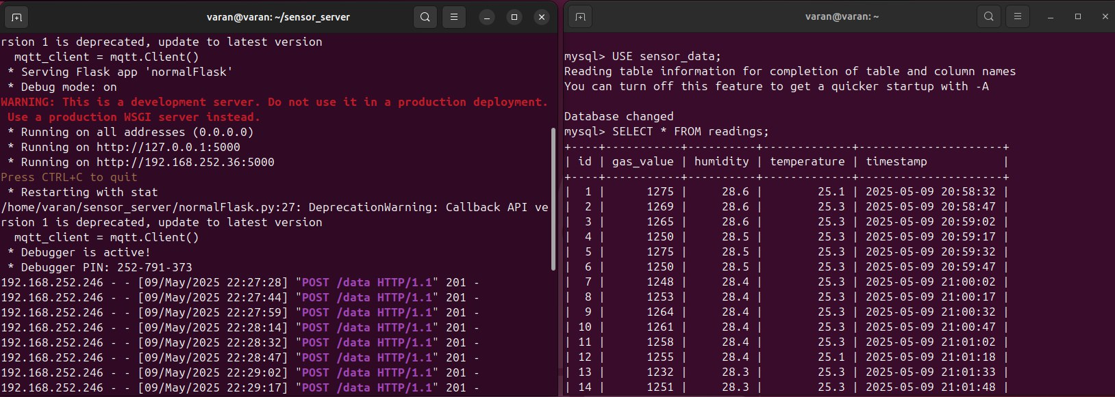
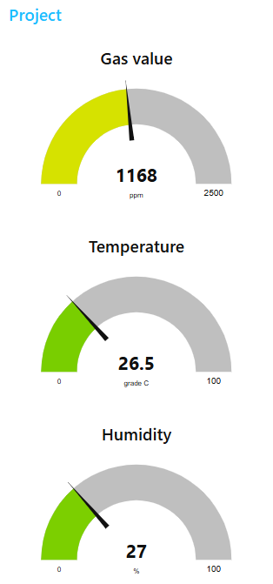
Data flow in Normal scenario
The Flask server after receiving the data from the ESP32 stores it in data base and sends it to the Nod-Red via MQTT protocol.

Slide 8
attack & defense - scenarios
There are two scenarios :
1 – simulate a DOS attack on the server & implement a defense mechanism.
2 – simulate a Data tampering attack & implement a defense mechanism.

Slide 9
attack & defense – scenario 1
Scenario 1 : simulate a DOS attack on the server & implement a defense mechanism.
DOS attack : floods a Flask server with excessive traffic , overwhelming its resources and making it unavailable to legitimate users (which is ESP32 in this case).
and this causing :
Server crashes (HTTP timeouts).
Database overload (MySQL slowdowns).
Blocked legitimate sensors data.

Slide 10
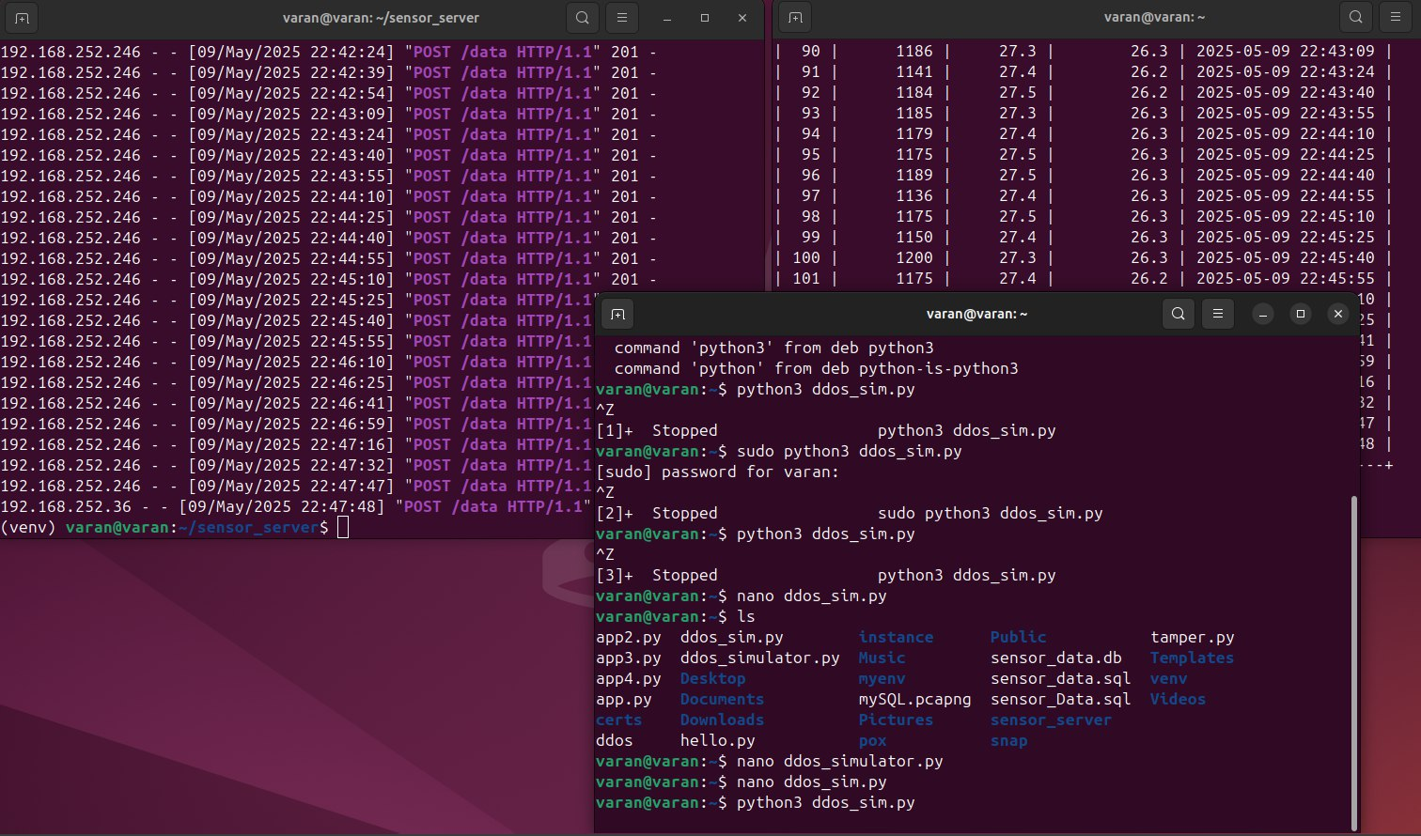
attack & defense – scenario 1
Implement the attack

Slide 11
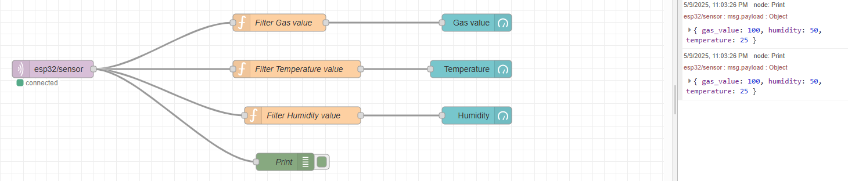
attack & defense – scenario 1
The values which sent from the server during the beginning of the DOS attack

Slide 12
attack & defense – scenario 1
There are two available options :
Rate Limiting:
Limits requests per IP address(e.g. 10 requests/minute)
Prevents server resource exhaustion
Firewall Rules (iptables/ UFW):
Blocks suspicious IP addresses
Filters malicious traffic patterns

Slide 13
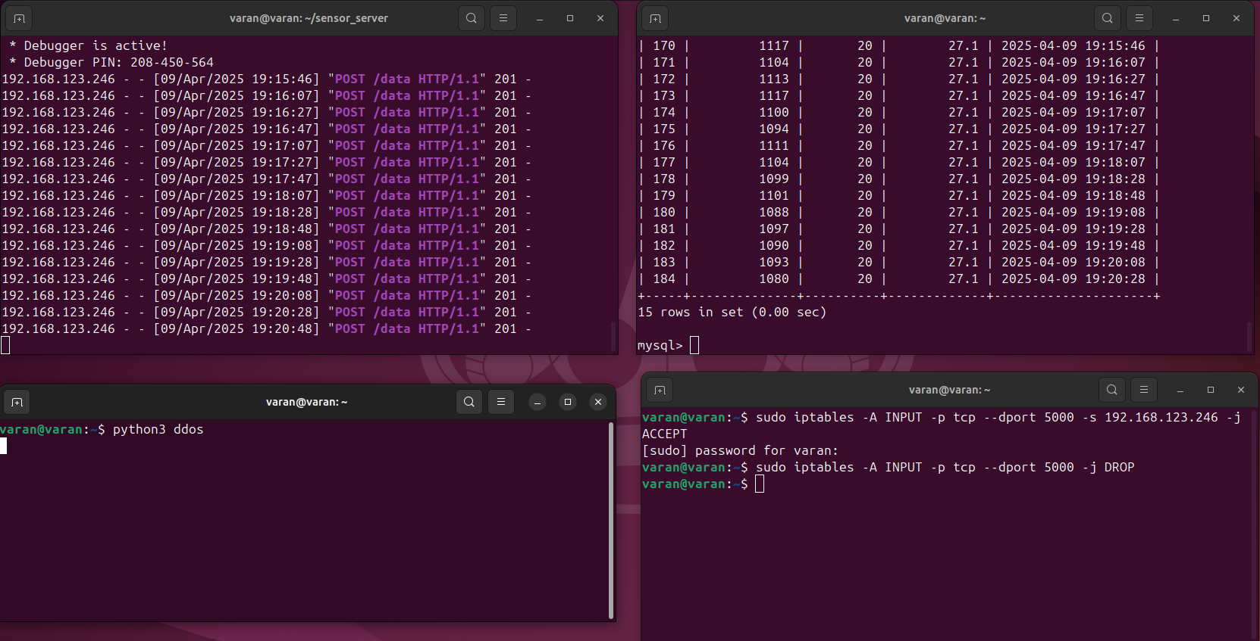
attack & defense – scenario 1
In scenario 1 : the Firewall Rules (iptables/ UFW) was used
Defense : Blocking suspicious or unknow IP addresses

Slide 14
attack & defense – scenario 2
simulate a Data tampering attack & implement a defense mechanism.
Data tampering attack is when an attacker captures and modifies data and then sends this incorrect data to the server , (e.g.in this case sending incorrect temperature or gas values after modifying it {"gas": 450} → {"gas": 0} // Fake "safe" reading)
and this causing :
Trigger false alarms.
Hide critical events (e.g., gas values leaks).
Corrupts database entries, misleads Node-RED dashboards, and compromises safety.
Manipulate analytics.

Slide 15
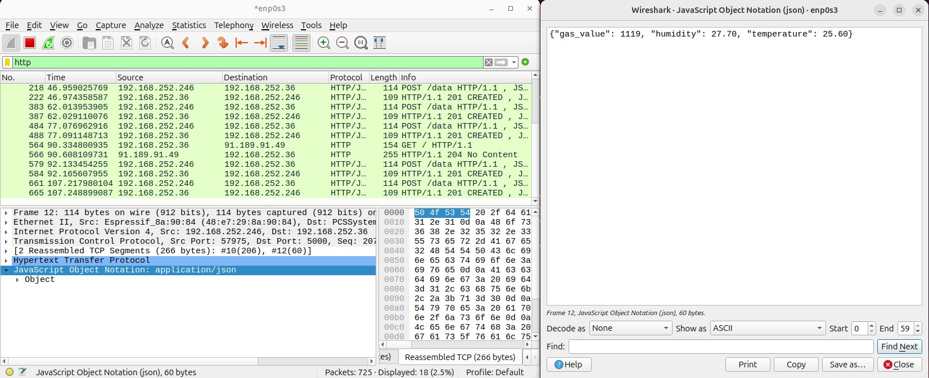
attack & defense – scenario 2
Capture the packet which sent from the ESP32 to the server by using Wireshark and knowing the format of the data.

Slide 16
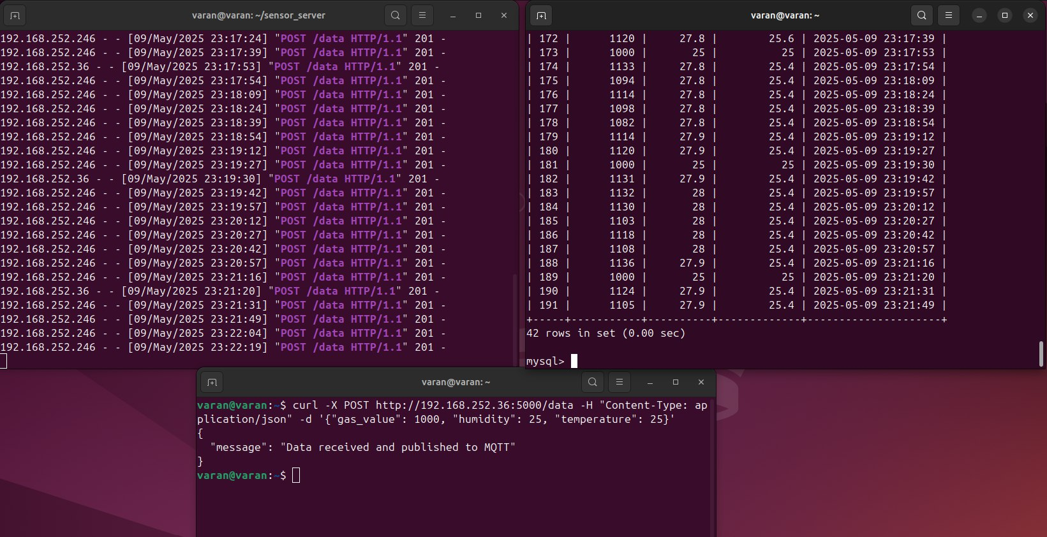
attack & defense – scenario 2
sending incorrect temperature & gas values to the server

Slide 17
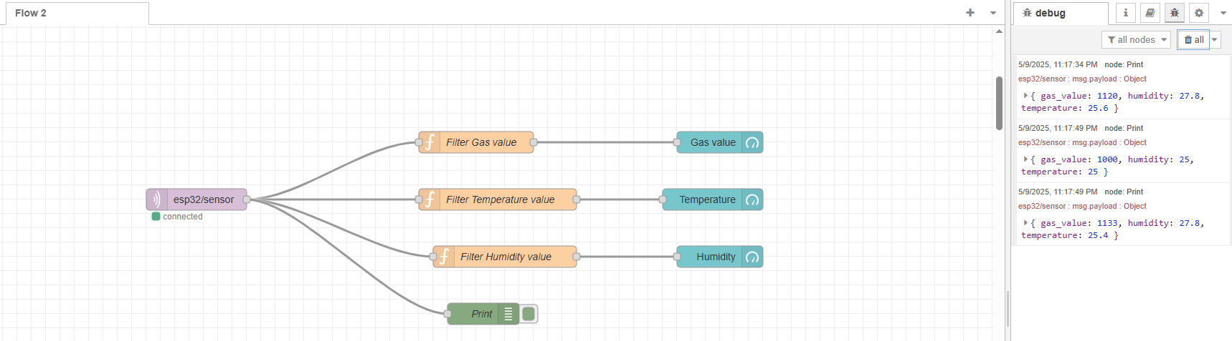
attack & defense – scenario 2
The server receives the incorrect data and then sends it to the Node-Red

Slide 18
attack & defense – scenario 2
There are two available options :
1- HMAC-SHA256 (Hash-based Message Authentication Code using SHA-256)
is a cryptographic mechanism that combines a secret key with a message and applies the SHA-256 hashing algorithm to produce a fixed-size output.
It provides both data integrity and authentication by ensuring that the message has not been tampered with and that it was generated by someone who knows the shared secret key.
2- Firewall Rules (iptables/UFW):
Blocks suspicious IP addresses
Filters malicious traffic patterns

Slide 19
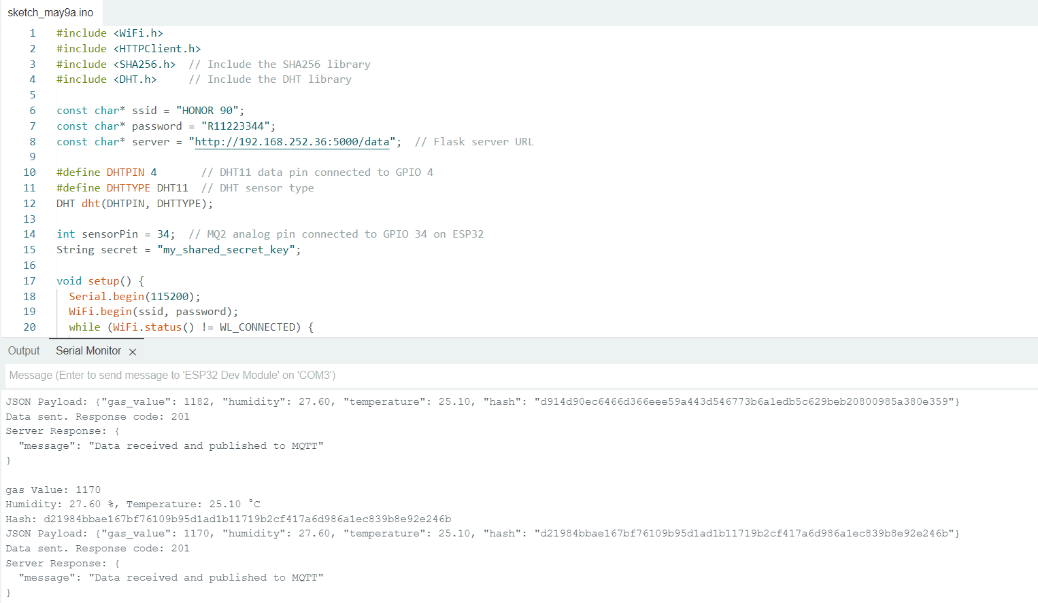
attack & defense – scenario 2
In scenario 2 : HMAC-SHA256 was used
ESP32: Sends a JSON payload that includes Data + Hash computed as SHA256(“Gas value, Humidity, Temperature" + secret key)
so, the ESP32 computes a SHA256 hash of the data string concatenated with a secret key and then sending it to the server.

Slide 20
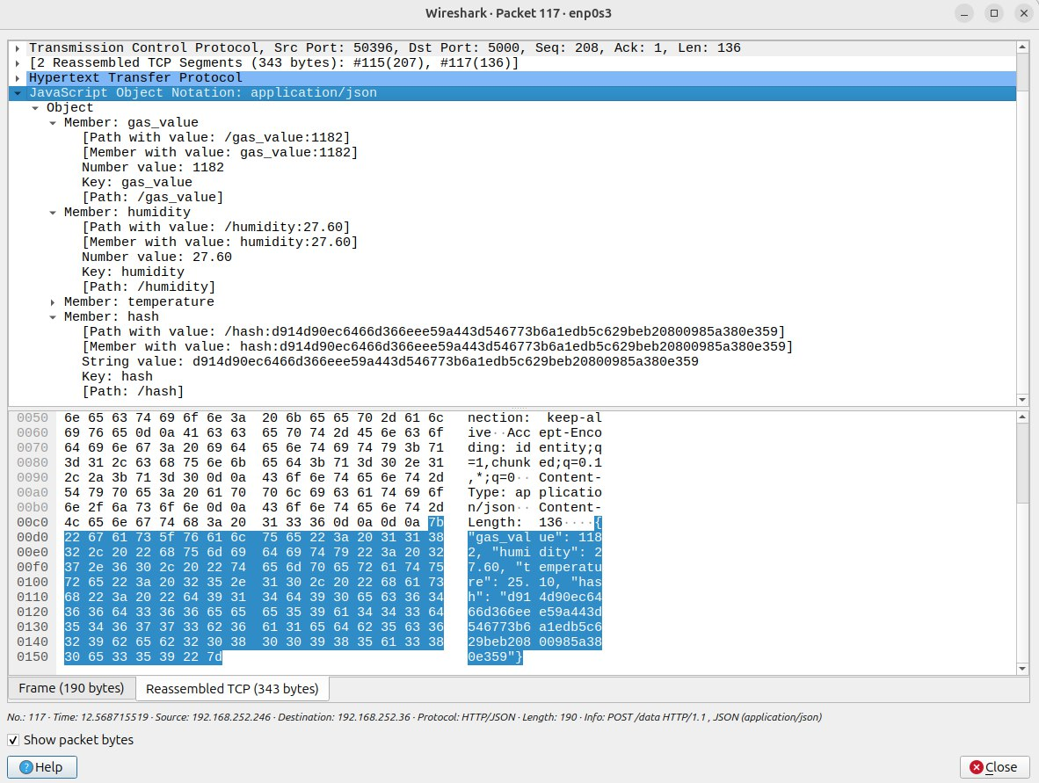
attack & defense – scenario 2
In Wireshark , after capture the payload:
even if the hash and the data are visible (because it is not encrypted), and the attacker try to change the values, they can't compute a valid hash ( without knowing the secret key), and the server will reject the request.
This is a lightweight and effective way to authenticate data from ESP32 to the server.

Slide 21
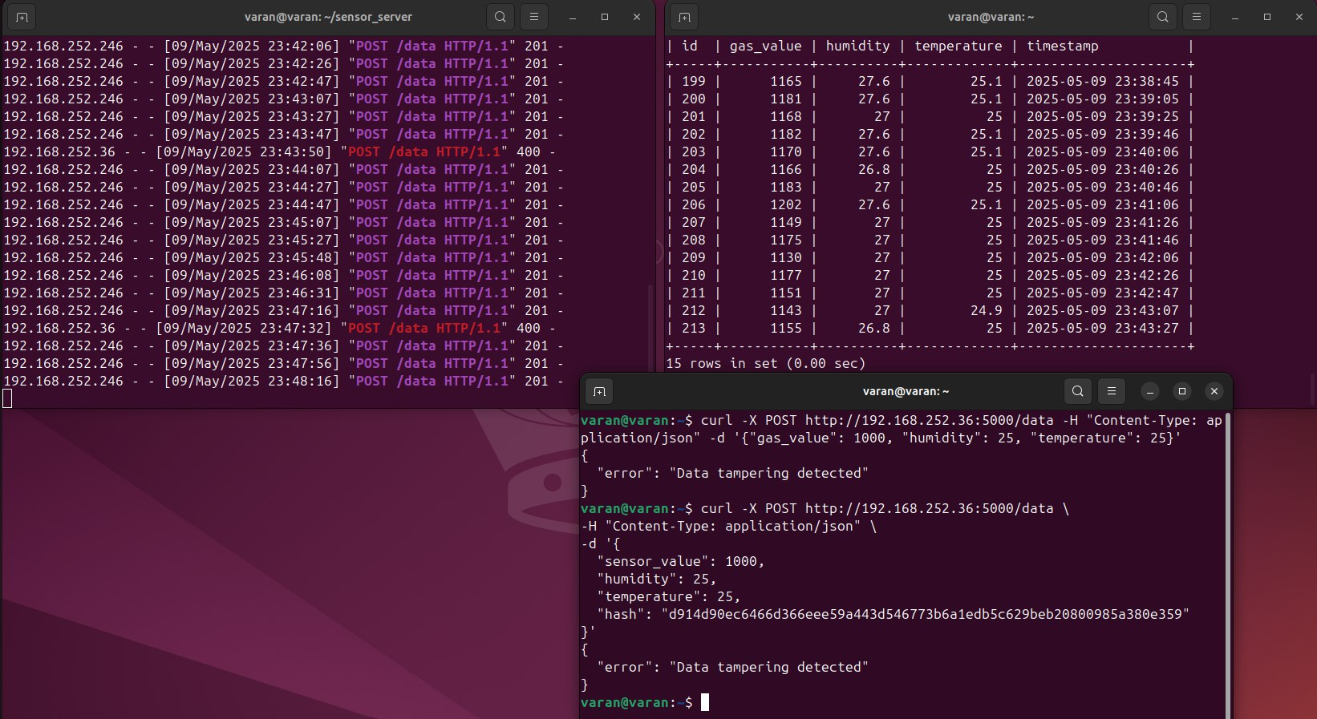
attack & defense – scenario 2
Server :
will extract the JSON payload and recompute the hash from data + secret in the same way.
verify the hash sent by the ESP32 by comparing it with its own locally computed hash.
If they match → data is accepted, and then send it to the Node-Red.

Slide 22
attack & defense – scenario 2
So, using HMAC-SHA256 provides :
1- Integrity : The hash ensures that the data hasn't been modified in transit. If even a single bit changes in Gas value, humidity, or temperature, the hash won't match.
2 – Authenticity : By including a secret key in the hash that only the ESP32 and server know, it proves that the data came from a trusted source (the ESP32).An attacker who doesn't know the secret can't forge a valid hash even if they know the data format.

Slide 23
Conclusion
This project demonstrates a secure IoT sensor data monitoring system.
It defends against data tampering using HMAC-SHA256 to ensure data integrity and authenticity, while firewall rules defend against DoS attacks.
A Flask server verifies hashes using a shared secret.
Real-time monitoring is achieved through MQTT and Node-RED
This architecture showcases a practical and effective approach to IoT security.

Slide 24
Thank you very much

